Slide 1
Assumptions
5.4 Data Screening

Slide 2
Assumptions
Important side notes:
For ANOVA, t-tests, correlation: you will use a fake regression analyses – it’s considered fake because it’s not the real analysis, just a way to get the information you need to do data screening.

Slide 3
Assumptions
Important side notes:
For regression based tests: you can run the real regression analysis to get the same information. The rules are altered slightly, so make sure you make notes in the regression section on what’s different.
You will also use other regression based values for this analysis.

Slide 4
Assumptions
Parametric tests based on the normal distribution assume:
Independence
Additivity and linearity
Normality something or other
Homogeneity (Sphericity), Homoscedasticity

Slide 5
Independence
The errors in your model should not be related to each other.
If this assumption is violated:
Confidence intervals and significance tests will be invalid.

Slide 6
Additivity and Linearity
The outcome variable is, in reality, linearly related to any predictors.
If you have several predictors then their combined effect is best described by adding their effects together.
If this assumption is not met then your model is invalid.

Slide 7
Additivity
One problem with additivity = multicollinearity/singularlity
The idea that variables are too correlated to be used together, as they do not both add something to the model.

Slide 8
Correlation
This analysis will only be necessary if you have multiple continuous variables
Regression, multivariate statistics, repeated measures, etc.
You want to make sure that your variables aren’t so correlated the math explodes.

Slide 9
Correlation
Multicollinearity = r > .90
Singularity = r > .95

Slide 10
Correlation
Run a bivariate correlation on all the variables
Look at the scores, see if they are too high
If so:
Combine them (average, total)
Use one of them
Basically, you do not want to use the same variable twice → reduces power and interpretability

Slide 11
Additivity: Check
Use the cor() function to check correlations
correlations = cor(dataset name with no factors, use = “pairwise.complete.obs”)

Slide 12
Additivity: Check
Whoa! Yikes!
Use the symnum() functions to view.
symnum(correlations)
Look for a * or B

Slide 13
Linearity
Assumption that the relationship between variables is linear (and not curved).
Most parametric statistics have this assumption (ANOVAs, Regression, etc.).

Slide 14
Linearity
Univariate
You can create bivariate scatter plots and make sure you don’t see curved lines or rainbows.
Ggplot2!
Damn that would take forever!

Slide 15
Linearity
Multivariate – all the combinations of the variables are linear (especially important for multiple regression and MANOVA)
Much easier – allows to check everything at once.
If this analysis is really bad, I’d go back to check the bivariate scatter plots to see if it’s one variable. Or run nonparametrics.

Slide 16
Linearity: Check
A fake regression to the rescue!
This analysis will let us check all the rest of the assumptions.
It’s fake because we aren’t doing a real hypothesis test.

Slide 17
Fake Regression
A quick note:
For many of the statistical tests you would run, there are diagnostic plots / assumptions built into them.
This guide lets you apply data screening to any analysis, if you wanted to learn one set of rules, rather than one for each analysis.
(BUT there are still things that only apply to ANOVA that you’d want to add when you run ANOVA).

Slide 18
Fake Regression
First, let’s create a random variable:
We will use the chi-square distribution function.
Why chi-square?
Mahalanobis used chi-square too…what gives?

Slide 19
Fake Regression
For many of these assumptions, the errors should be chi-square distributed (aka lots of small errors, only a few big ones).
However, the standardized errors should be normally distributed around zero.
(don’t get these two things confused – we want the actual error numbers to be chi-square distributed, the zscored ones to be normal).
Draw a picture.

Slide 20
Fake Regression
Create a random chi-square with the same number of participants as our data.
rchisq(number of random things, df)
random = rchisq(
nrow(noout), ##number of people
7) ##magic number

Slide 21
Fake Regression
Now what do I do with that?
Run a fake regression with the new random variable as the DV.
Use the lm() function.

Slide 22
Fake Regression
Lm arguments:
lm(y~x, data=data) (loads more options, here’s the ones you need).
Y = DV
X = IV
In this example only we can use a . To represent all the columns. Normally you would have to type them out by column name.
Data = data set name

Slide 23
Fake Regression
fake = lm(random~., data=noout)
I saved it as fake to be able to view the diagnostic plots.

Slide 24
Linearity: Check
Now that I have that done, let’s make the linearity plot – called a normal probability plot. Or just a PP Plot.
(Note: we are using QQ Plots, same diff).

Slide 25
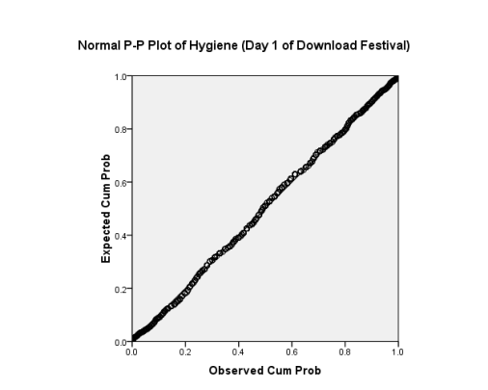
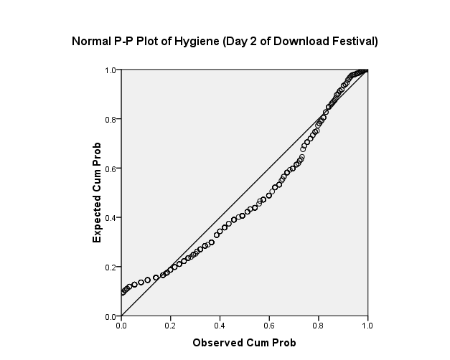
The P-P Plot
Normal
Not Normal

Slide 26
Linearity: Check
What is this thing plotting?
The standardized residuals (draw).
These are zscored values of how far away a person’s predicted score is from their actual score.
We want to use zscores because they make it easy to interpret and give us probabilities.

Slide 27
Linearity: Check
Get the standardized residuals out of your fake regression:
standardized = rstudent(fake)
Plot that stuff:
qqnorm(standardized)
Add a line to make it easy to interpret
abline(0,1)

Slide 28
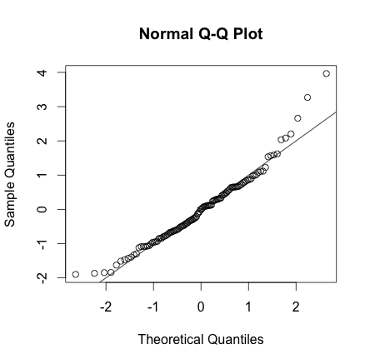

Slide 29
Normally Distributed Something or Other
This assumption tends to get incorrectly translated as ‘your data need to be normally distributed’.

Slide 30
Normally Distributed Something or Other
We actually assume the sampling distribution is normal.
So if our sample is not then that’s ok, as long as we have enough people to meet the central limit theorem.
How can we tell?
N > 30
OR
Check out the sample distribution as an approximation.

Slide 31
When does the Assumption of Normality Matter?
In small samples.
The central limit theorem allows us to forget about this assumption in larger samples.
In practical terms, as long as your sample is fairly large, outliers are a much more pressing concern than normality.

Slide 32
Normality
Univariate – the individual variables are normally distributed
Check for univariate normality with histograms
And skew and kurtosis values.

Slide 33
Normality
Get skew and kurtosis:
Use the moments package, it’s happiness.
Code:
skewness(dataset, na.rm=TRUE)
kurtosis(dataset, na.rm=TRUE)
Note: all columns must be int or num.

Slide 34
Normality
What do these numbers mean?
You are looking for values that are less than the absolute value of 3 – same rule as univariate outliers.
One variable has bad kurtosis values.
Generally, since we have enough people, I’d ignore this value.
But it can be helpful in figuring out why the next graph is bad.

Slide 35
Normality
Multivariate – all the linear combinations of the variables need to be normal
Basically if you ran the Mahalanobis analysis – you want to analyze multivariate normality.

Slide 36
Normality: Check
We are going to use those standardized residuals again to check out normality.
hist(standardized, breaks=15)

Slide 37
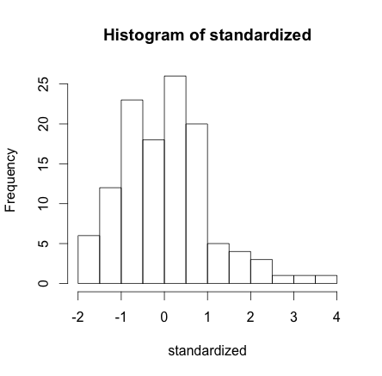

Slide 38
Normality: Check
What to look for:
See the numbers centered around zero at the bottom?
You want an even spread around zero … so it shouldn’t look like -2 to 0 to +4 … that’s not even.

Slide 39
Homogeneity
Assumption that the variances of the variables are roughly equal.
Ways to check – you do NOT want p < .001:
Levene’s - Univariate
Box’s – Multivariate
We will use those with their specific analysis.

Slide 40
Homogeneity
Sphericity – the assumption that the time measurements in repeated measures have approximately the same variance
Difficult assumption…
We will use Mauchley’s test when we get to repeated measures.

Slide 41
Homogeneity

Slide 42
Homoscedasticity
Spread of the variance of a variable is the same across all values of the other variable
Can’t look like a snake ate something or megaphones.
Best way to check both of these is by looking at a residual scatterplot.

Slide 43
Spotting problems with Homogeneity or Homoscedasticity

Slide 44
Homog+s: Check
Create a scatterplot of the fake regression.
X = standardized Fitted values = the predicted score for a person in your regression.
Y = standardized Residuals = the difference between the predicted score and a person’s actual score in the regression (y – y hat).
Make them both standardized for an easier scale to interpret.

Slide 45
Homog+s: Check
We are plotting them against each other. In theory, the residuals should be randomly distributed (hence why we created a random variable to test with).
Therefore, they should look like a bunch of random dots (see below).

Slide 46
Homog+s: Check
Make the fit values standardized
fitvalues = scale(fake$fitted.values)
Plot those values
plot(fitvalues, standardized)
abline(0,0)
abline(v = 0)

Slide 47
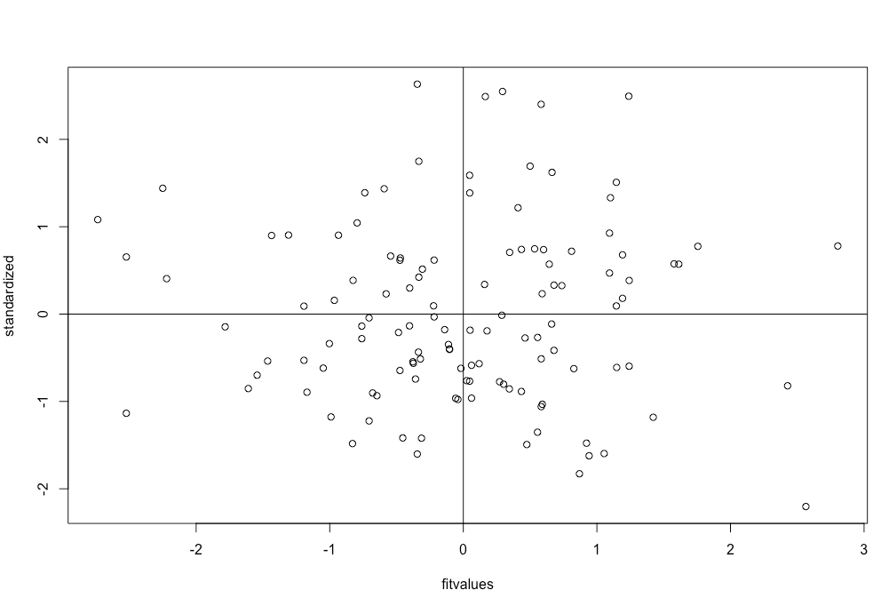

Slide 48
Homog+s: Check
Homogeneity – is the spread above that line the same as below that 0, 0 line (both directions)?
You do not want a very large spread on one side and a small spread on the other side (looks like it’s raining).

Slide 49
Homog+s: Check
Homoscedasticity – is the spread equal all the way across the x axis?
Look for megaphones or big lumps.
It should look like a bunch of random dots. You do not want shapes. You can draw an imaginary line around all the dots. Should be a blob or block of dots.

